Slide 1
Predicting Employee Attrition
- IBM HR Analytics
Mentor :
Prof. Kasha Dehnad
Team Members:
Nitasha Sharma
Shruti Tripathi
Taranpreet Singh

Slide 2
Project Objective
Our goal is to uncover the factors that lead to employee attrition by exploring important questions such as impact of job profile, years spent at the company, education, business travel and gender on the attrition rates in a company.
Data Source:
Kaggle IBM HR Analytics Employee Attrition & Performance dataset: https://www.kaggle.com/pavansubhasht/ibm-hr-analytics-attrition-dataset

Slide 3
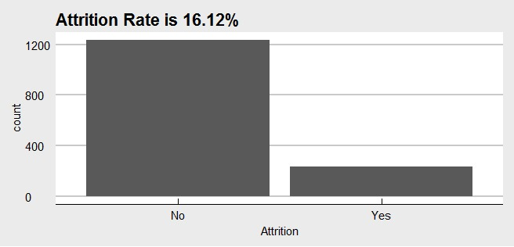
Exploratory Data Analysis
Imbalanced Binary Classification Problem

Slide 4
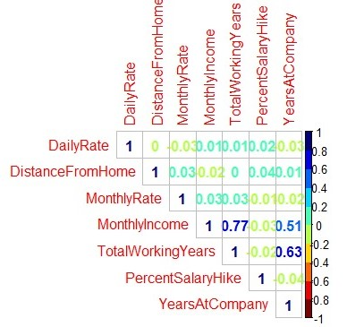
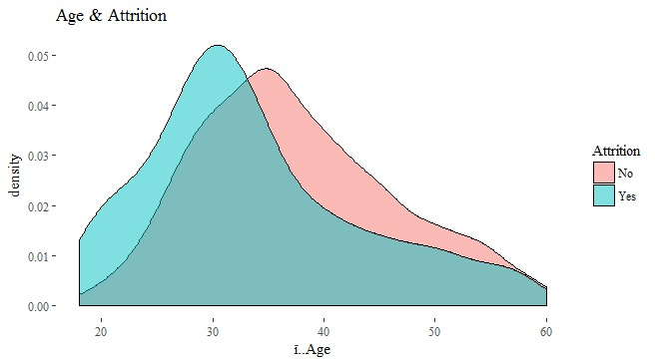
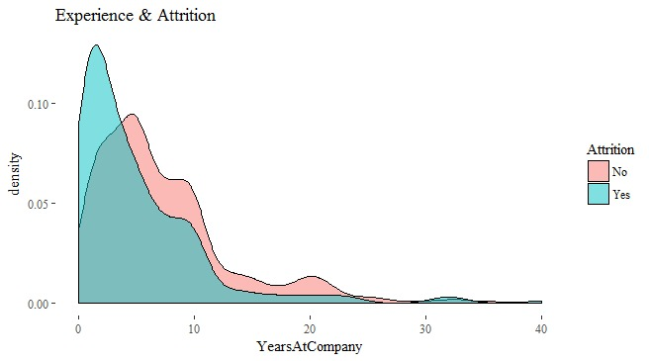
Attrition with Numeric variables

Slide 5
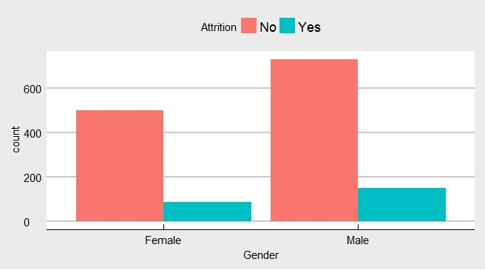
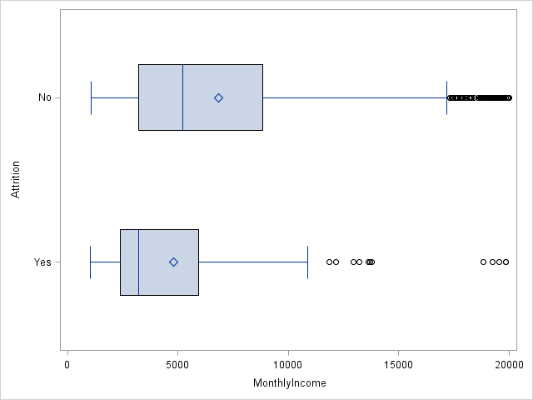
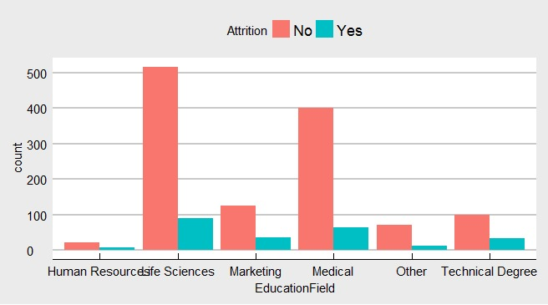
Attrition with Categorical Variables

Slide 6
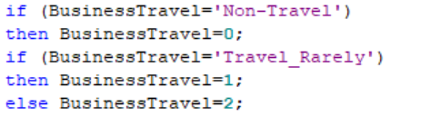
Data Preprocessing
Encoding Categorical Variables:
N-1 levels one hot encoding
Eg: Marital Status consists of 3 levels – Single, Married, Divorced
Generated 2 new variables: Single and Married.
For Ordinal categorical variables we converted to Integer Variables
Eg:
Standardizing the variables

Slide 7
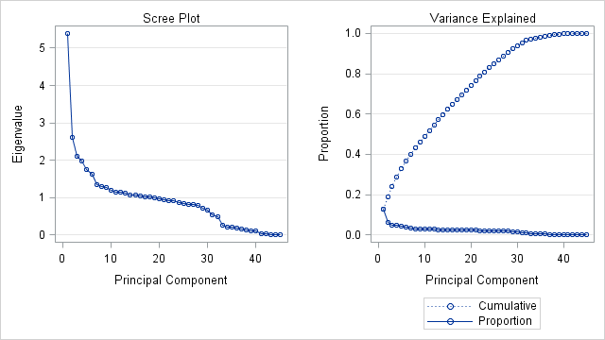
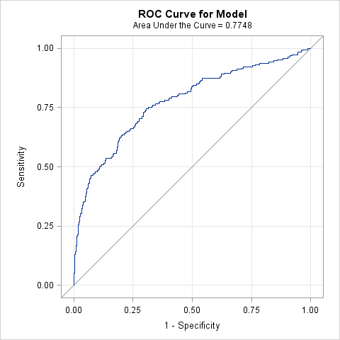
Dimension Reduction
Principal Component Analysis: Running Logistic Regression on first 18 principal components we have the following analysis:

Slide 8
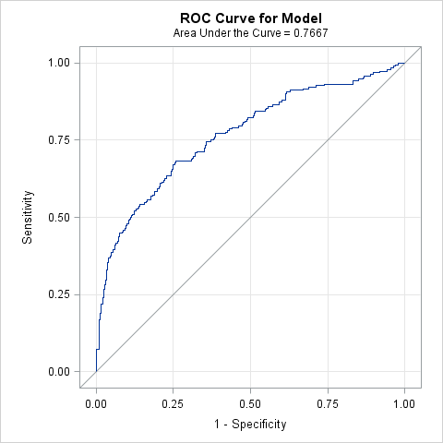
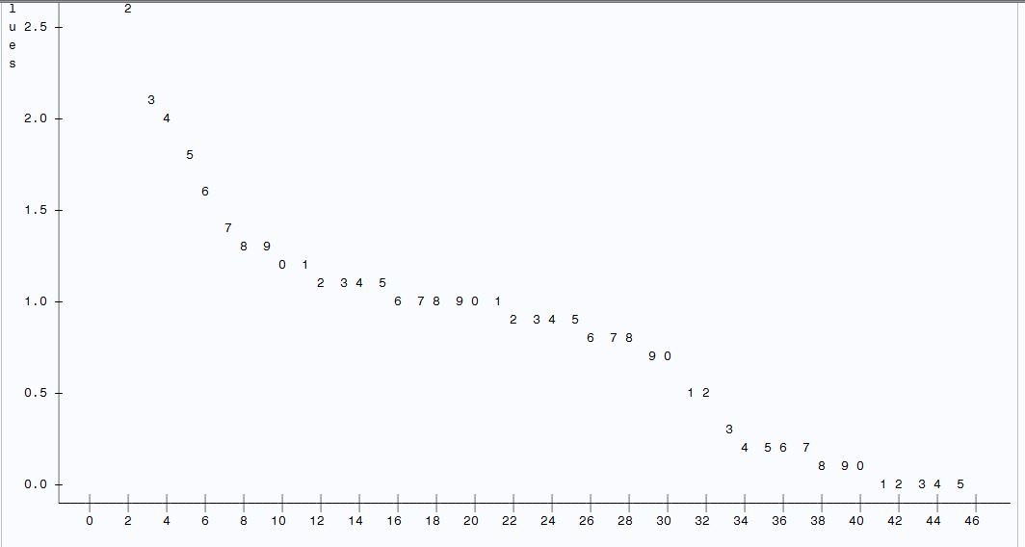
Dimension Reduction
Factor Analysis: Running Logistic Regression on first 15 factors, we have the following analysis:

Slide 9
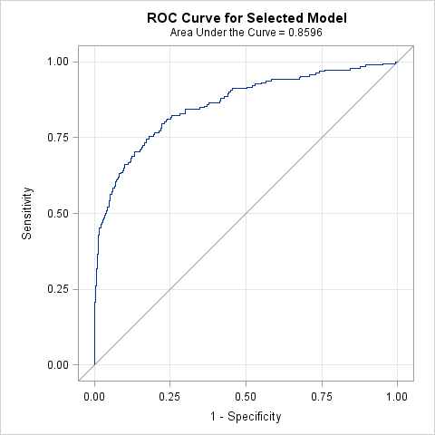
Final Model - Performance
For the final model we trained the training data using Logistic regression with the stepwise selection process as it gave the maximum AUC of 0.8596 and accuracy of 86%. On the test set, the accuracy was 80%.

Slide 10
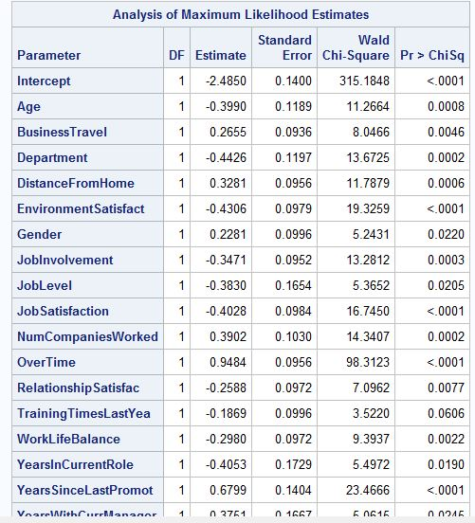
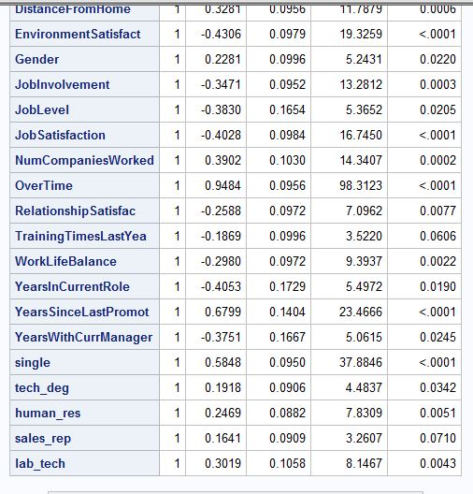
Final Model – Variables selected

Slide 11
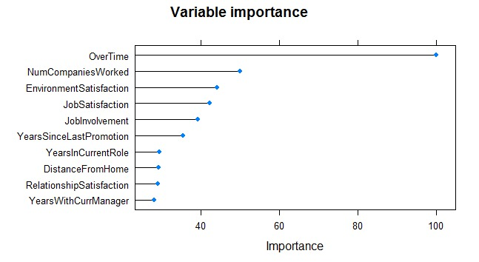
Conclusion
Other methods tried:
For balanced prediction we used up-sampling technique.
We also changed class weights of classifier according to proportion of target variable in R.
Top 10 important variables as per maximum absolute T statistic values as calculated in R:

Slide 12
THANK YOU!

